Slide 1
Sales prediction
Data Analysis and Machine Learning model
By- Arsh Abel Kumar

Slide 2
Average Amount spent on TV advertising
By Analysing the dataset we conclude that the average amount spent on TV advertising was $147.0425

Slide 3
Correlation between radio advertising expenditure and product sale
When we find out the correlation matrix for the correlation between radio advertising and product sale, we get the following matrix:
[[1. 0.34965074]
[0.34965074 1. ]]
From the matrix, we can clearly conclude that these two variables are weakly related since the score is closer to 0.

Slide 4
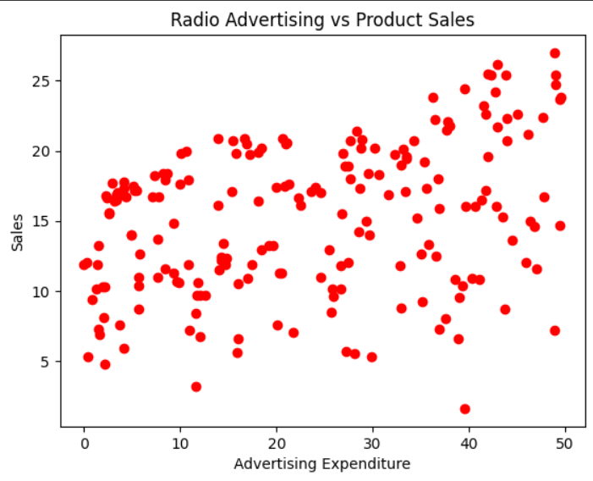
graph

Slide 5
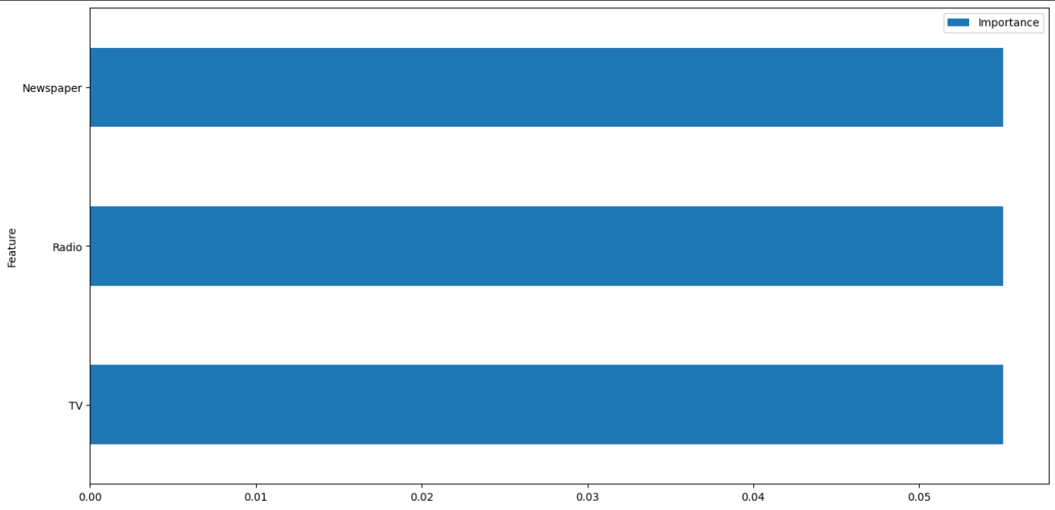
Impact of each variable
Graph:

Slide 6
When we look at the graph for the importance of each variable, we find out that each variable has an equal impact on the output variable

Slide 7
Sales prediction
We use the Multiple Linear Regression model for the sales prediction because it’s an example of Supervised Data prediction.
Thus, we divide the data into two sets: training and testing set.
And, based on the model created by the training set we predict the sales values for the testing set.
The following is the predicted values vs actual values table alongwith the MSE.

Slide 8
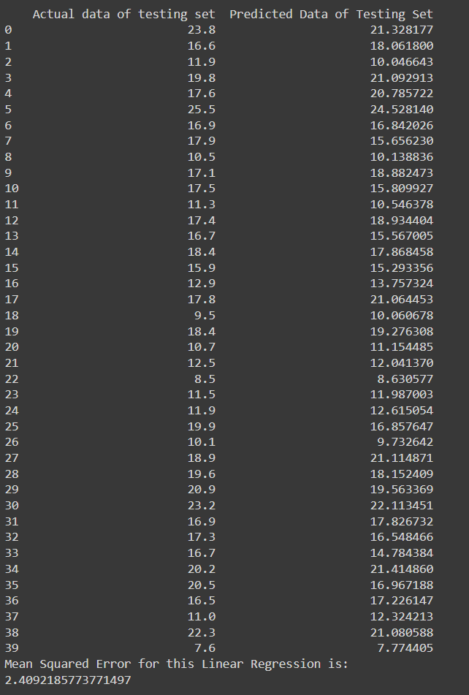

Slide 9
Predicting Sales on a new data
We predict sales on new dataset of advertising expenditures: $200 on TV, $40 on Radio, and $50 on Newspaper.
The Sales comes out to be:19.7321937

Slide 10
Does normalizing the data change the result?
We now normalise the data by feature scaling which makes all the features at the same scale.
But, at the end, we come to the conclusion that normalizing the data doesn’t have any effect on our model, since the predicted values come out to be same and so does the MSE

Slide 11
Sales Prediction with only Radio and Newspaper
Now, we use only two of the three variables that affect the sales, namely Radio and Newspaper advertising.
We come to a conclusion that, the predicted values are much further than the tested values, and also, the MSE comes out to be very high.

Slide 12
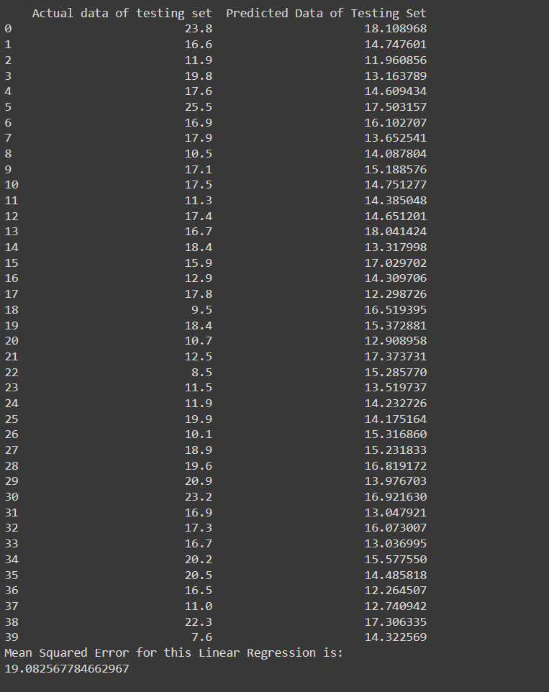

Slide 13
Thank you

